Slide 1
18-551 | S’12 | Group #1 transOptic
Alex Baran
James Chun
Tom Keagle

Slide 2
The Problem
Tourism
Language barriers
Limited translations

Slide 3
The Solution
Android app to translate the world
Capture image input
Get translated text output

Slide 4
More Specifically
Capture image of foreign text
*Segment characters
*Use OCR to convert to ASCII
Recombine words
*Translate to another language
(*) – Major tasks

Slide 5
Previously, in 18-551
Album Digitization
Minimum Average Correlation Energy (MACE) filters
Handwriting Recognition
Thresholding
Segmentation
Support Vector Machine (SVM)
License Plate Recognition
Adaptive Binarization

Slide 6
Current Plan
Implement Segmentation
Image preprocessing
Character -> word recombination
Create OCR
Feature selection & extraction
Classification
Translate in JavaScript

Slide 7
Character Segmentation
Experimented with different implementations
Connected-Component based methods [Ohya et al.]
Binarization with local thresholding, detection with gray-level difference of shapes and sizes
Pros
Able to extract and recognize chars
Good under varying illuminating conditions
Cons
Susceptible to noise
Text alignment is restricted
Upright, Not connected, monochrome
J. Ohya, A. Shio, and S. Akamatsu, Recognizing Characters in Scene Images,
IEEE Transactions on Pattern Analysis and Machine Intelligence, 16 (2) (1994) 214-224.

Slide 8
Character Segmentation
Current Approach – Edge Detection
Morphological Approach [Hasan and Karam]
RGB components form a weighted grayscale
Edges are identified using a morphological gradient operator
Adaptive thresholding for binary edge image
Usage of dilation and erosion to form candidate regions, remove noise
Pros
Robust to noise, insensitive to skew and text orientation
Cons
Current implement seems susceptible to illuminating conditions
Yassin M. Y. Hasan and Lina J. Karam, Morphological Text Extraction from Images, IEEE Transactions on Image Processing, 9 (11) (2000) 1978-1983.

Slide 9
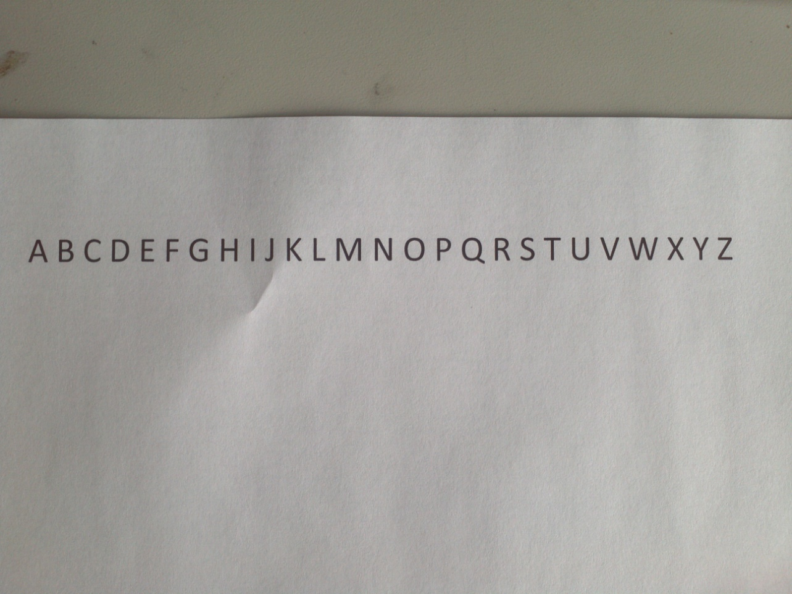
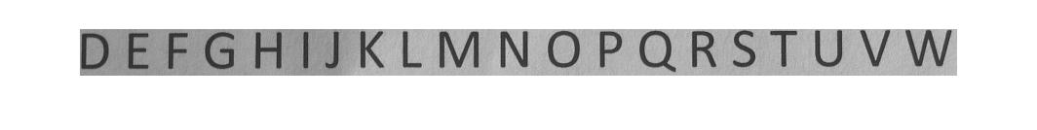
Character Segmentation

Slide 10
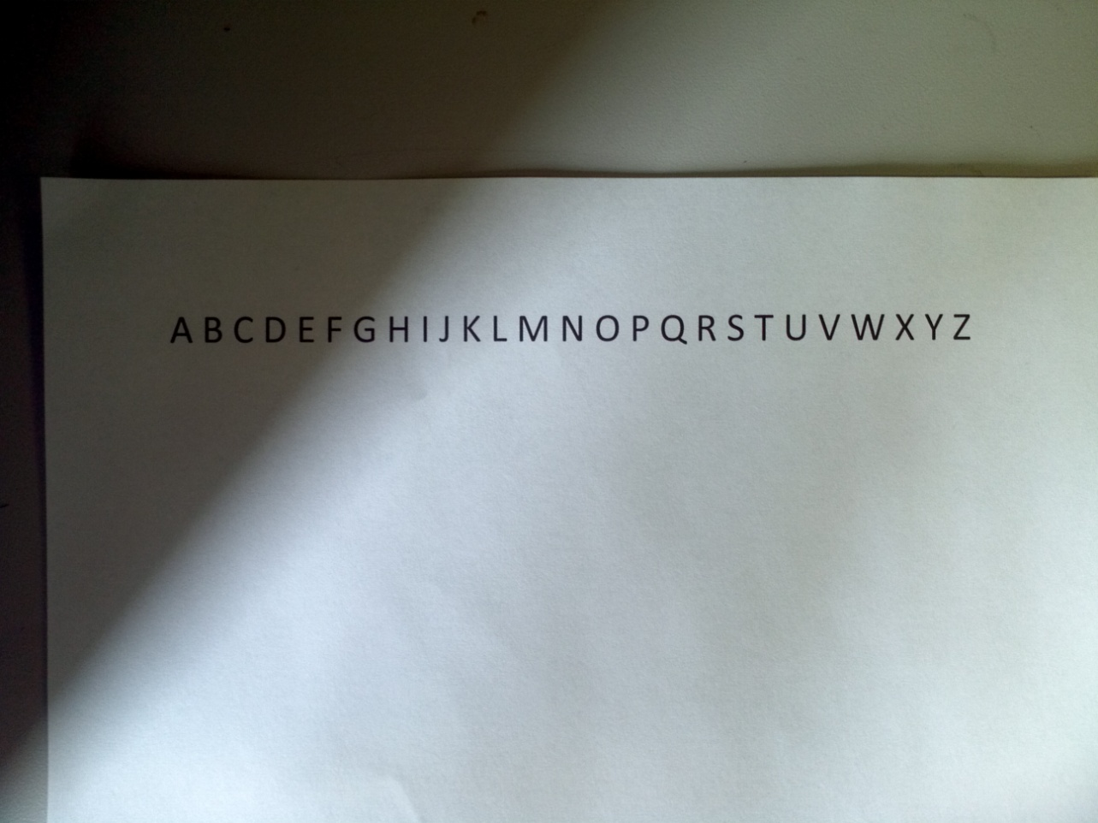
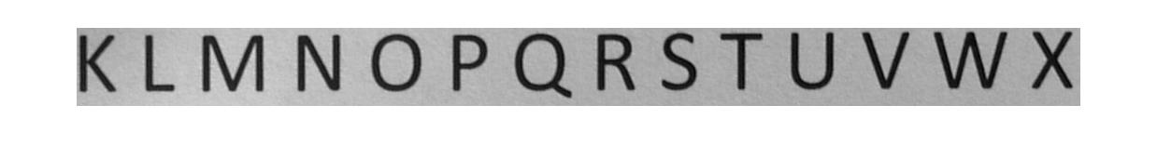
Character Segmentation

Slide 11
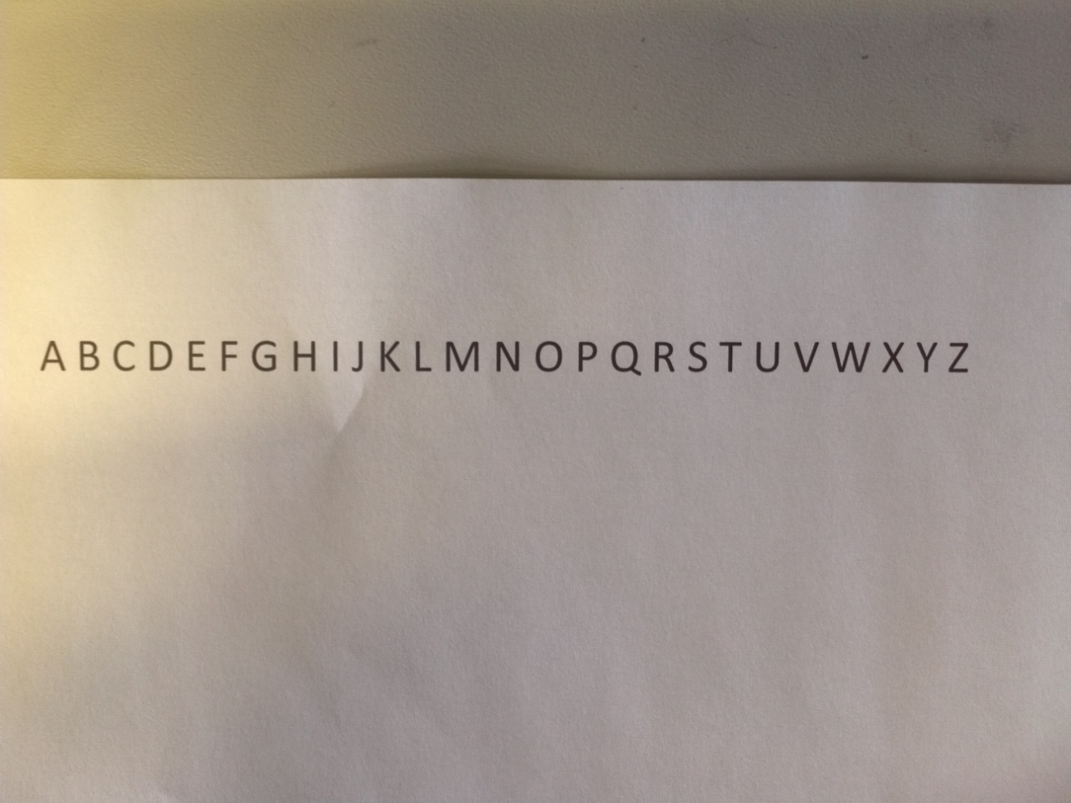
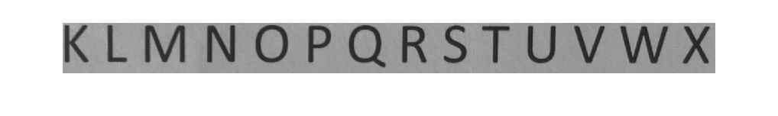
Character Segmentation

Slide 12
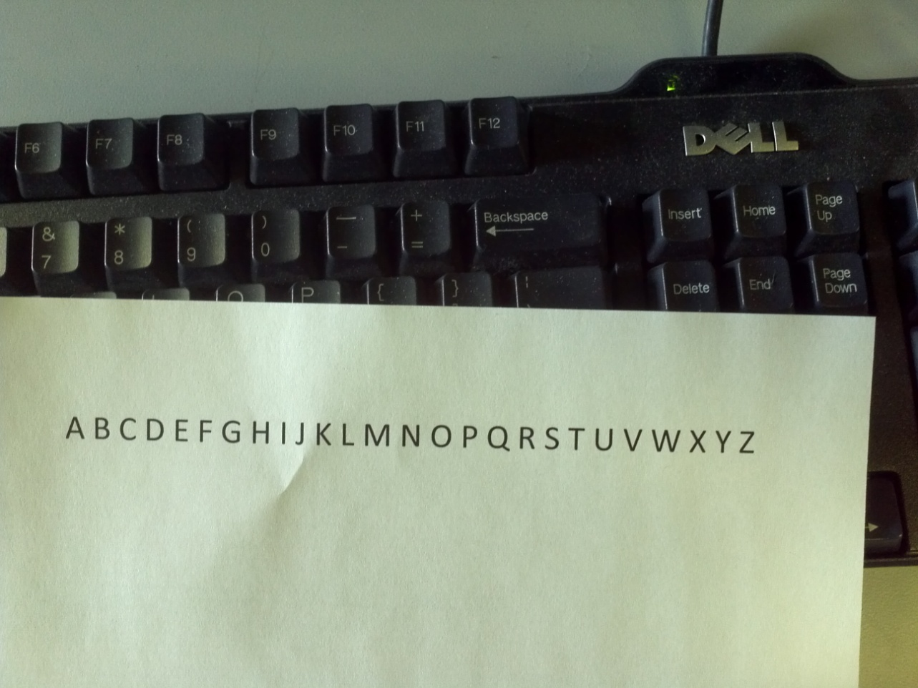
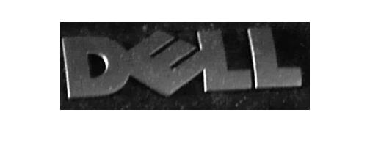
Character Segmentation

Slide 13
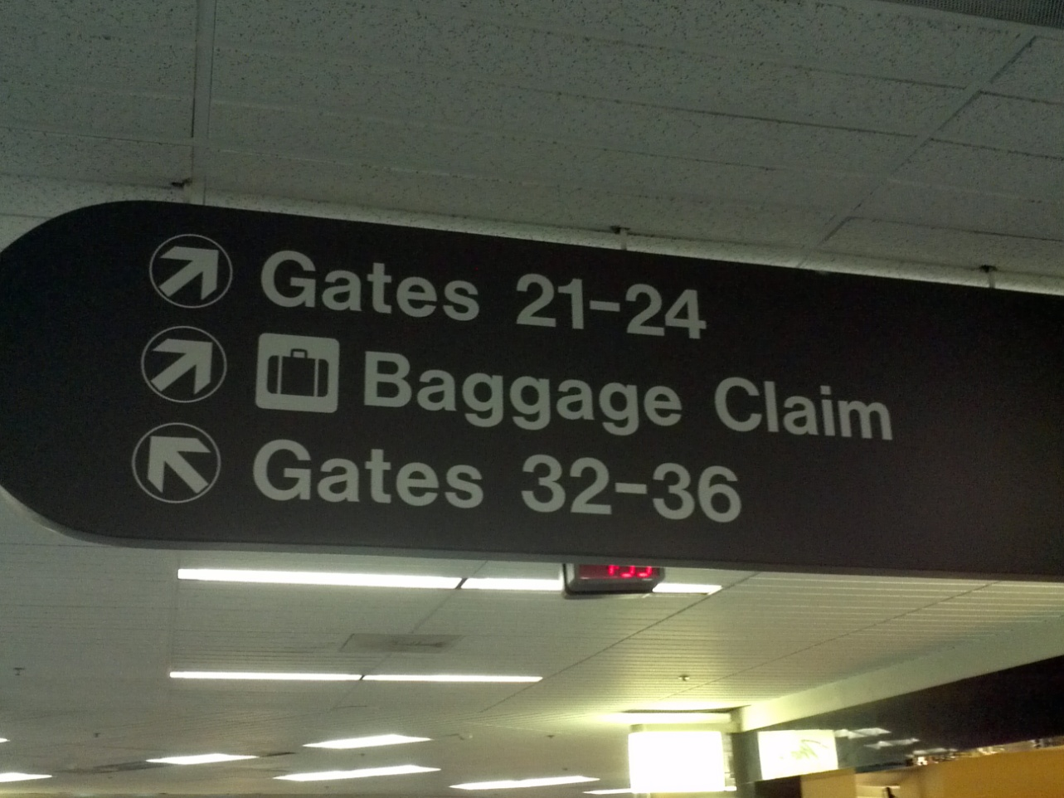
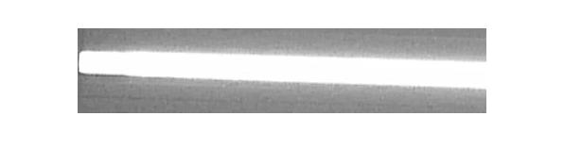
Character Segmentation

Slide 14
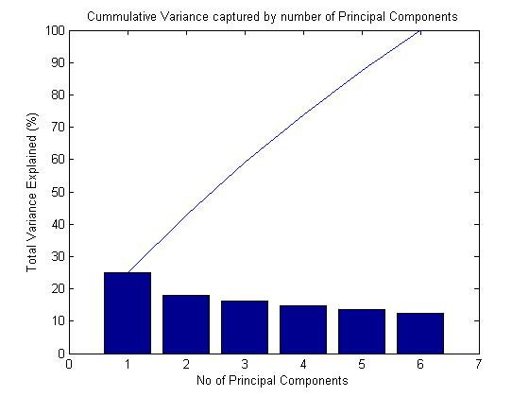
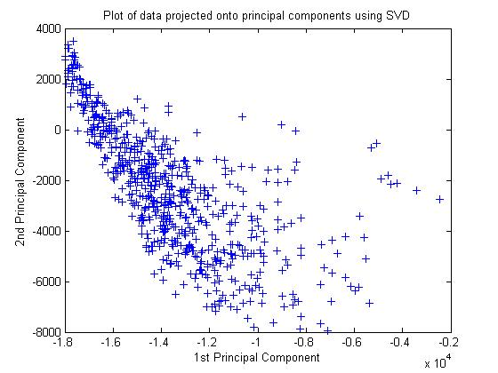
Optical Character Recognition
Accuracy: ~87%
Training Size: 900, Test Size: 180
Number of Basis: 3

Slide 15
Translation
Google API v2
Cheap (1M chars for $20)
Issues in Java
Example code doesn’t work
Outdated class references
Noted problems with Eclipse
No additional Java documentation
Solution
JavaScript – possibly in C
Representational State Transfer (REST)

Slide 16
Final Demo
Full system demo
Several example sentences
3-5 different languages

Slide 17
Revised Schedule
Week | Alex | James | Tom
4/1 | Test OCR in MATLAB | Implement Segmentation | Implement OCR in C and MATLAB
4/8 | Design Interface | Implement OCR in C | Implement OCR in C
4/15 | Integrate Translation | Finalize GUI | Finalize GUI
4/22 | Demo prep | Demo prep | Demo prep

Slide 18
References
Character Segmentation
J. Ohya, A. Shio, and S. Akamatsu, Recognizing Characters in Scene Images, IEEE Transactions on Pattern Analysis and Machine Intelligence, 16 (2) (1994) 214-224.
Yassin M. Y. Hasan and Lina J. Karam, Morphological Text Extraction from Images, IEEE Transactions on Image Processing, 9 (11) (2000) 1978-1983.
OCR
P. W. Frey and D. J. Slate. "Letter Recognition Using Holland-style Adaptive Classifiers". (Machine Learning Vol 6 #2 March 91)
Translation
Google Translate API - <http://code.google.com/apis/language/translate/overview.html>
Jonathan Stark’s “Building Android Apps with HTML, CSS, and JavaScript” from O’Reilly - <http://ofps.oreilly.com/titles/9781449383268/index.html>

Slide 19
Questions?

